Slide 1

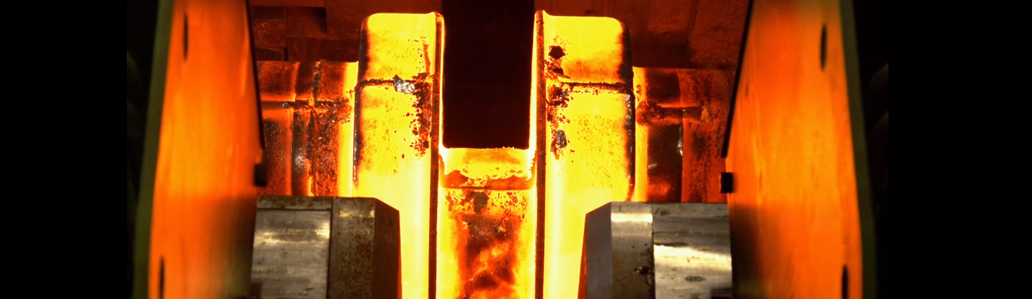

Welcome to Orientation

Slide 2
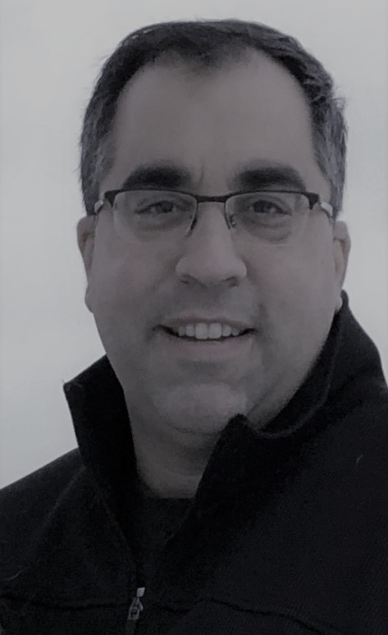
Message from Ellwood Crankshaft Group President
Welcome to our organization and to the fine team of people who work here!
You are an essential worker and have been hired to perform a valuable job. I hope that by providing you competitive compensation package in a respectful work environment, our relationship will continue to prosper for years to come.
I want to share some of our history, goals, values, mission and vision with you. There will be a short question and answer at the end to insure I have done my job introducing the organization to you.
Let’s go a little deeper into the company.
Message From Brian C. Taylor
Notes:
Welcome to our organization and to the fine team of people who work here.
You are an essential worker and have been hired to perform a valued job. I hope that by providing you competitive compensation in a respectful work environment this relationship will continue to prosper for years to come

Slide 3
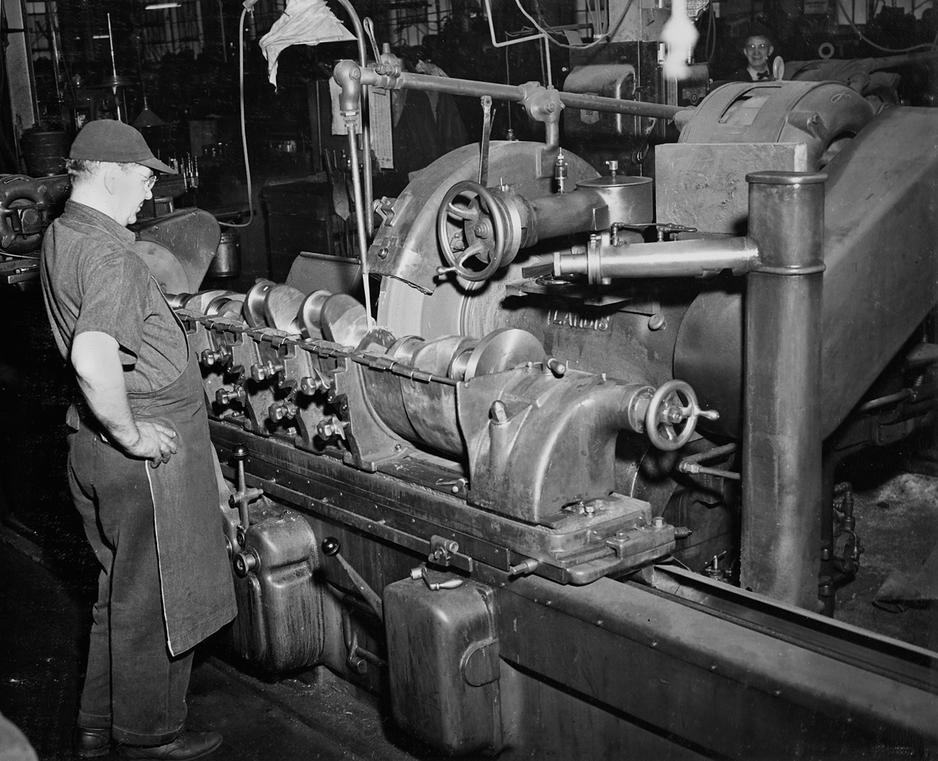
Message from Ellwood Crankshaft Group President
ELLWOOD Group is a private, family-owned business who has operated since 1910. We are different than many organizations for the following reasons:
We take a long-term approach
We operate with fiscal discipline and responsibility
We have a safety-first culture, and
We focus on continuous improvement for our long term viability.
At the ELLWOOD Crankshaft Group, we have adopted the same philosophy as our parent company.
Notes:
Welcome to our organization and to the fine team of people who work here.
You are an essential worker and have been hired to perform a valued job. I hope that by providing you competitive compensation in a respectful work environment this relationship will continue to prosper for years to come

Slide 4

Message from Ellwood Crankshaft Group President
Our organization promotes an open-door philosophy that benefits everyone who works here. An important part of this philosophy is to maintain open and honest communication and we believe this has been one of the reasons for our continued success since 1910.
You are encouraged to talk with your supervisor about any concerns you may have regarding your job or any aspect of the organization. If your supervisor doesn’t have the answer to your question, you’ll be directed to someone who can answer.
We are committed to treating each person as an individual. We treat each person with dignity and respect. We work together directly and as a team to accomplish our mission. We insure a healthy, non-hostile environment to which to work free from abuse and favoritism.
Notes:
Welcome to our organization and to the fine team of people who work here.
You are an essential worker and have been hired to perform a valued job. I hope that by providing you competitive compensation in a respectful work environment this relationship will continue to prosper for years to come

Slide 5

Message from Ellwood Crankshaft Group President
Another corner stone of good communication is the ability to deal directly with each other without intervention by a 3rd party. Our entire ELLWOOD company has been nonunion for over 110 years. We greatly value our direct relationship with our employees.
Our employer-employee relationship allows us to quickly resolve inevitable changes that arise from time to time in the workplace. Our direct relationship allows us to rapidly and effectively respond to changing market conditions. Our relationship allows us to gain advantages over less agile competitors.
You have my commitment that this organization encourages you to talk with your supervisor, human resources, general manager or me about any concerns you may have regarding the organization.
Notes:
Welcome to our organization and to the fine team of people who work here.
You are an essential worker and have been hired to perform a valued job. I hope that by providing you competitive compensation in a respectful work environment this relationship will continue to prosper for years to come

Slide 6
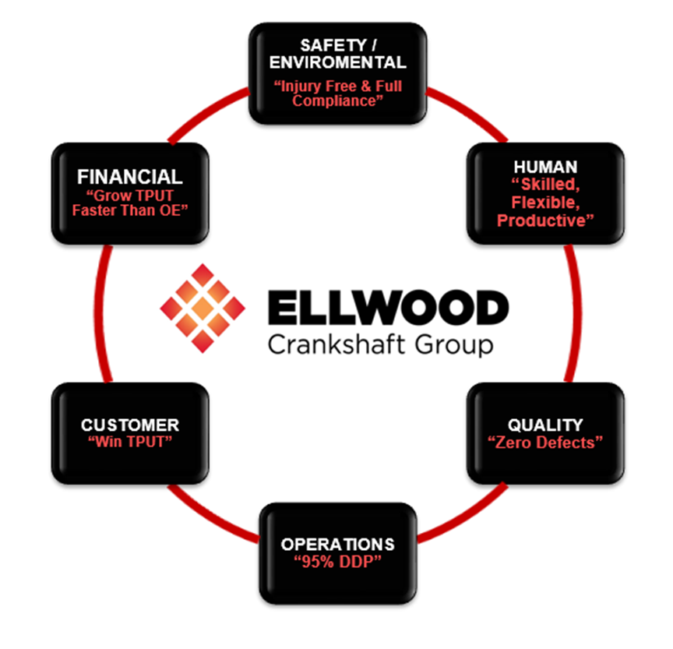
Message from Ellwood Crankshaft Group President
We manage our business by driving the six elements. The six elements are the foundation of our business and everything starts with the management of these 6 basic areas.
The six elements serve as our strategic business goals. We want everyone in the organization to understand the overall goals, what impacts these goals and how to contribute to the success of these goals.
The six elements focus on the areas on the chart.
  Safety and Environmental
  Human
  Quality
  Operations
  Customer
  Financial
Notes:
Our six strategic elements are a commonsense approach Of doing the right thing.
the first element is safety and environmental and our philosophy is to be “injury free” every day and “environmentally compliant” every day or second strategic element is related to quality we want to have “Zero defects” Every day. Doing the right thing.
Our third strategic element is that of the human element. And we want to have a “healthy, skilled and flexible workforce” doing the right thing.
If for strategic element is that of the operations in our goal is to have “due date performance of 95% to all customers” this is simply being on-time, every time.
Our fifth strategic element is that related to our customers, we want to “win new strategic throughput”. You might be asking yourself what is TPUT? TPUT is simply our value add into the raw material less our truly variable expenses. As long as we grow TPUT faster than our Operating Expenses we are generating income. This very point becomes our #6 strategic element.
Or six strategic element is that related to our financials and our goal here is to increase throughput faster than our operating expenses. We increase TPUT by booking favorable work and becoming smarter and more productive every day.
The six elements are very much common sense oriented with attainable goals in order for us to have a successful business we take this a step further and provide a financial incentive or reward for all of our workers to continuously improve and reinforce the positive behaviors related to the six elements. our entire business is aligned around the six elements from orientation to our handbook to our performance appraisals to our At risk and pay all associated with rewarding the positive behaviors of the six elements.
Welcome to our organization and to the fine team of people who work here.
You are an essential worker and have been hired to perform a valued job. I hope that by providing you competitive compensation in a respectful work environment this relationship will continue to prosper for years to come

Slide 7
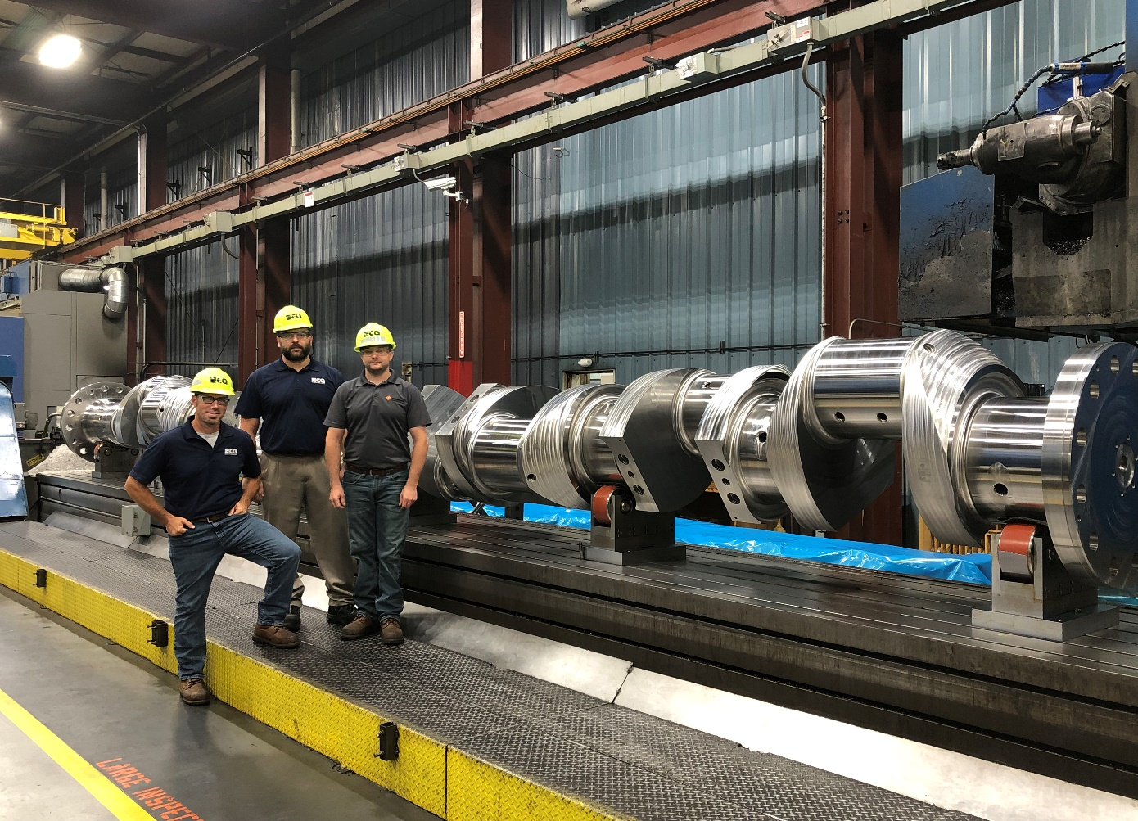
Message from Ellwood Crankshaft Group President
Within the operations element, we also have a goal to run equipment in the most productive way possible.
We have pioneered a new approach to our CNC equipment over the past 2 years. We are running more and more unmanned hours by automating much of the process of large crank making.
This allows an operator to run multiple machine tools and increases our overall productivity while completing more hours during each shift.
The result is increased incentive dollars split amongst fewer employees. The entire organization is working to move towards a multiple machine operation to maximize profits and incentive payouts to every employee.
Notes:
Welcome to our organization and to the fine team of people who work here.
You are an essential worker and have been hired to perform a valued job. I hope that by providing you competitive compensation in a respectful work environment this relationship will continue to prosper for years to come

Slide 8
Message from Ellwood Crankshaft Group President
In summary, the results of managing the six elements link directly to our incentive plan which means the better the results, the better the monthly incentive payout.
The results are also tied to your individual performance appraisals. All personal reviews are based on your individual management of these six elements.
The six strategic elements represent our barometer for the business. If we are meeting the goals, we are managing the business exceptionally well.
Notes:
Our six strategic elements are a commonsense approach Of doing the right thing.
the first element is safety and environmental and our philosophy is to be “injury free” every day and “environmentally compliant” every day or second strategic element is related to quality we want to have “Zero defects” Every day. Doing the right thing.
Our third strategic element is that of the human element. And we want to have a “healthy, skilled and flexible workforce” doing the right thing.
If for strategic element is that of the operations in our goal is to have “due date performance of 95% to all customers” this is simply being on-time, every time.
Our fifth strategic element is that related to our customers, we want to “win new strategic throughput”. You might be asking yourself what is TPUT? TPUT is simply our value add into the raw material less our truly variable expenses. As long as we grow TPUT faster than our Operating Expenses we are generating income. This very point becomes our #6 strategic element.
Or six strategic element is that related to our financials and our goal here is to increase throughput faster than our operating expenses. We increase TPUT by booking favorable work and becoming smarter and more productive every day.
The six elements are very much common sense oriented with attainable goals in order for us to have a successful business we take this a step further and provide a financial incentive or reward for all of our workers to continuously improve and reinforce the positive behaviors related to the six elements. our entire business is aligned around the six elements from orientation to our handbook to our performance appraisals to our At risk and pay all associated with rewarding the positive behaviors of the six elements.
Welcome to our organization and to the fine team of people who work here.
You are an essential worker and have been hired to perform a valued job. I hope that by providing you competitive compensation in a respectful work environment this relationship will continue to prosper for years to come

Slide 9
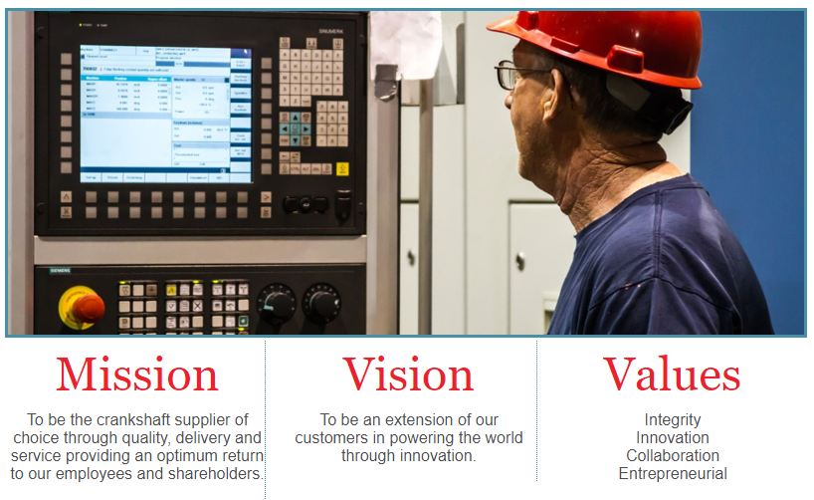
Message from Ellwood Crankshaft Group President
Let’s look at our organizations mission and vision to better understand the overall company you have joined.
Our mission defines who we are as an organization. We want to be the crankshaft supplier of choice through quality, delivery and service providing an optimum return to our employees and shareholders.
Our vision defines where we want to go as an organization. We want to be an extension of our customers in powering the world through innovation.
Notes:
Welcome to our organization and to the fine team of people who work here.
You are an essential worker and have been hired to perform a valued job. I hope that by providing you competitive compensation in a respectful work environment this relationship will continue to prosper for years to come

Slide 10
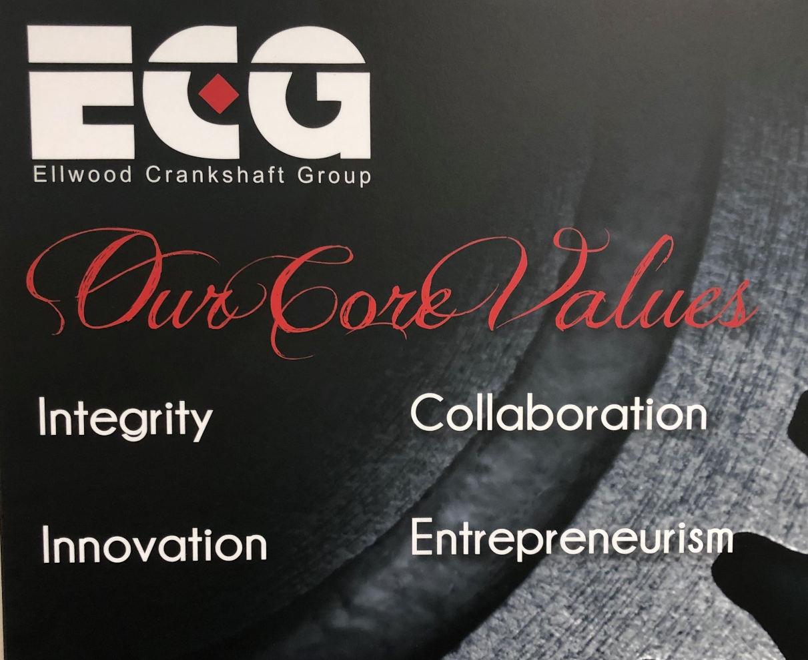
Message from Ellwood Crankshaft Group President
Our core values are a commonsense approach to our relationships with customers and our employees. Its how everyone would like to be treated and in turn treat others. This includes:
Integrity Collaboration
Innovation Entrepreneurism
These values should drive your individual relationships with your peers, supervisors and members of management.
Notes:
Our first core values that of integrity. We simply want to do what’s right at all times in all relationships.
Our second core value is that of collaboration. We want to have open discussion and conversation with every individual person in our company. Collaboration makes us stronger as two heads are certainly better than one.
Or third core value is that of entrepreneurialism because you want each member of the organization to be personally responsible and make independent judgment as to the best way to manage their area of the business.
Or fourth quarter value is that of Innovation. We aspire to continuously improve and innovate every day including our relationships, processes, procedures and business goals.
Welcome to our organization and to the fine team of people who work here.
You are an essential worker and have been hired to perform a valued job. I hope that by providing you competitive compensation in a respectful work environment this relationship will continue to prosper for years to come

Slide 11

The prospects for our future are bright and exciting.
Our success is based on us working together to find innovative solutions for our customers. With your help and cooperation, our success will continue.
Again, welcome to the team, we think you are going to like it here.

Slide 12
Message from Ellwood Crankshaft Group President
Question and Answer:
How many fundamental elements define our business?
Do we pay incentive dollars based on the results of these elements?
What year was ELLWOOD founded?
Is ELLWOOD a public or family owned private company?
Does ELLWOOD pride itself on having open door policy?
Notes:
Welcome to our organization and to the fine team of people who work here.
You are an essential worker and have been hired to perform a valued job. I hope that by providing you competitive compensation in a respectful work environment this relationship will continue to prosper for years to come

